Slide 1
Person-Centered Care for
People with Dementia
Katie Maslow
Institute of Medicine
Sheila L. Molony
Connecticut Community Care, Inc. (CCCI)
Feb. 13, 2014

Slide 2
Call Objectives
Participants will learn about:
Origin and current status of person-centered care for people with dementia in the U.S.
Key concepts and implications for care systems and service providers
Key components of person centered care coordination

Slide 3
Origin of Person-Centered Care for People with Dementia
Tom Kitwood in England: recognition of negative stereotypes and their impact on people with dementia, care, and services
Convergence of similar insights among dementia care providers and researchers in the U.S., Canada, Australia, and other countries
Ongoing refinement of key concepts and alternate approaches to care

Slide 4
Relationship with “Patient-Centered Care”
Two movements growing in parallel in the U.S.
Strong government focus on “patient-centered care” as a means and goal to improve care for people of all ages with various conditions and care needs
“Patient-centered care” is defined as care that is “respectful of and responsive to individual patient preferences, needs, and values and ensuring that patient values guide all clinical decisions (IOM, 2001)
Similar but not identical movements create the potential for misunderstandings in the context of dementia care

Slide 5
Key Concept:
Each person with dementia is unique
This is a philosophical or ethical statement that is:
  Obvious to all of us, but
  Rarely incorporated in care procedures and services
Implications for care systems and service providers
  Need for recognition of the heterogeneity of people with dementia
  Need for procedures (and time) to learn about each person/client/consumer
  Need for an array of services to address individual situations

Slide 6
Key Concept:
The person/self continues to exist despite loss of cognitive abilities
Countering negative stereotypes
  It is said, and many people believe, “the self is lost;” the person is only “an empty shell”
  Consider the impact on the person with dementia, the family, other caregivers, people who will develop dementia
Implications for care systems and service providers
  Need to develop an organizational culture that counters stereotypes
  Need to provide training/learning experiences for staff

Slide 7
Key Concept:
The person has remaining strengths and non-cognitive abilities
This is another philosophical statement that is:
  Obvious to all of us, but
  Many systems and providers do not routinely assess for strengths and non-cognitive abilities
Implications for care systems and service providers
  Need to expand staff perceptions of dementia to include strengths and non-cognitive abilities
  Need to create assessment procedures (and time) for staff to learn about a person’s strengths and non-cognitive abilities
  Need to provide training about care planning and service referrals that build on strengths and non-cognitive abilities

Slide 8
Key Concept:
People with dementia can express values and preferences
Extensive research shows:
  This is true for people in early and moderate stages of dementia
  Their expressed values and preferences are generally consistent over time
Implications for care systems and service providers
  Need for procedures (and time) to learn about the person’s values and preferences
  Need for training for staff about how to learn about values and preferences in people with dementia
Potential for misunderstanding in “patient-centered care”

Slide 9
Key Concepts:
Relational- or Relationship-centered care
Well-recognized
  hands-on and other help provided by family caregivers of people with dementia
  Similar kinds of help provided by other paid caregivers
A different concept: hands-on and other help are provided in a relationship, and the relationship itself can support or undermine personhood and functioning in people with dementia
How can this concept be incorporated in care systems and services?

Slide 10
Possible misunderstandings in “patient-centered care”
Strong emphasis on autonomy - can result in questions about how care systems and service providers can and should work with families
Strong emphasis on patient use of information to self-manage - can result in questions about if and how people with dementia can be involved and benefit
Strong emphasis on quality measurement based on patient-reported experience of care - can result in questions about how to measure quality of care

Slide 11
Familiar and Unfamiliar Concepts and Approaches to Care
Further information and discussion in the Fall 2013 issue of Generations, the journal of the American Society on Aging
Issue includes articles on the person-centered care for people with dementia in different stages of the condition and in various care situations: home, residential care, primary medical care, hospital, care transitions, and care management.
Provides suggestions for training about the key concepts and their implementation in these care settings.

Slide 12
Key Components of Person – Centered Care Coordination
Valuing the person; demonstrating high regard
Gaining trust (individual and family)
  Takes time, ongoing contact and relationship skills
Listening and observing
  Learning what really matters at a particular point in time
Using multiple sources/informants
  Learning about person’s values, history, preferences
  Learning what brings person joy
Believing in individuals capacity for success and wellbeing
Taking action to support well-being

Slide 13
Advanced Skills
Ease in unstructured situations
Ability to tolerate uncertainty
Flexibility
Creativity
Dementia-specific knowledge

Slide 14
Training Needed
Person-Centered Care
  Person-centered philosophy and values
  Person-first language
  Relationship and communication skills
  Self-determination
  Strengths-based care planning
  Meaningful activity and engagement
  Case-based problem-solving
Persons with Dementia
  Recognizing cognitive impairment
  Differentiating delirium depression, dementia
  Preventing excess disability in all stages of disease, all dementia types
  Anticipatory guidance and risk mitigation
  Decisional capacity and surrogate decision making
  Planning to reduce avoidable hospitalizations

Slide 15
Impact of Environment
Physical, social and experiential environment
  Isolating vs. supporting; stressful vs. comforting
  Social and physical environment as a therapeutic tool
Care giving environment
  Family members
  Formal caregivers (How many? How skilled?)
  Adult day health centers (Adult “night” health centers)
Medical care environments
  Risk for iatrogenic harm
  Risk for under-recognition of symptoms, illness

Slide 16
Strategies
  Individual level
    Identify preferences expressed in behaviors and words
    Identify topics, places, relationships that bring comfort
    Maintain opportunities for accomplishment, contribution and self-worth
    Recognize ability of person to be fully present “in the moment” and to participate in choices and decisions
  Family level
    Use clear, concrete terms when discussing potential challenges and risks
    Support family in understanding disease and their changing role in providing support
    Create back-up plans

Slide 17
Strategies (continued)
  Organizational level
    Share person-centered philosophy and values
    Provide supportive supervision
    Provide initial and ongoing training
    Share best practices
    Conduct outreach
  Policy level
    Include person centeredness and dementia in required curricula for care providers
    Identify best practices in care coordination for persons with dementia
    Identify quality outcomes measures that include indicators of thriving

Slide 18
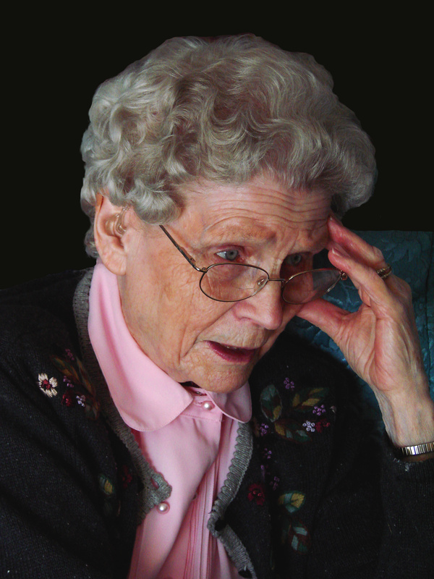
Case Study
Mrs. G

Slide 19
Your comments and questions

